Slide 1
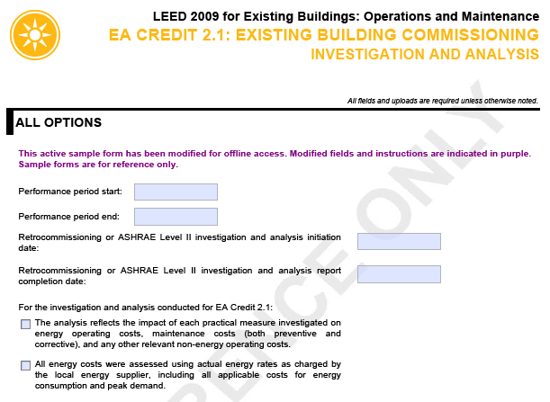

Provide the Performance Period dates for the credit consistent with the rest of your project. Then provide the specific dates of your Cx or auditing work and the date that your analysis report was completed.
Confirm that all of the noted requirements have been met by checking these boxes.

Slide 2
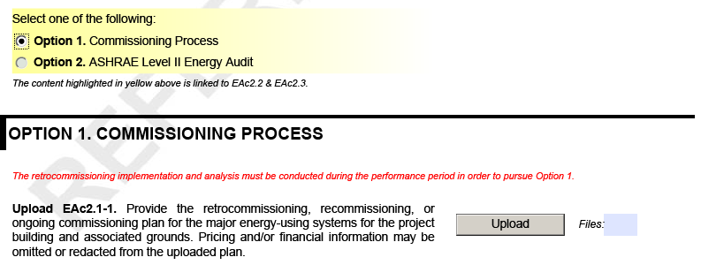
If your team pursued Commissioning, select Option 1 and upload your Cx plan from the Performance Period.

Slide 3
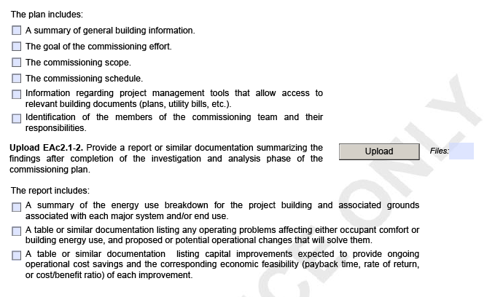
Then confirm that the Cx plan includes each of the following components and check off the boxes accordingly. Use this as a checklist to confirm that the plan is complete.
Upload the finalized Cx report. Check off the boxes confirming that each of these components have been included in the report. Use this as a checklist to confirm that the report is complete.

Slide 4
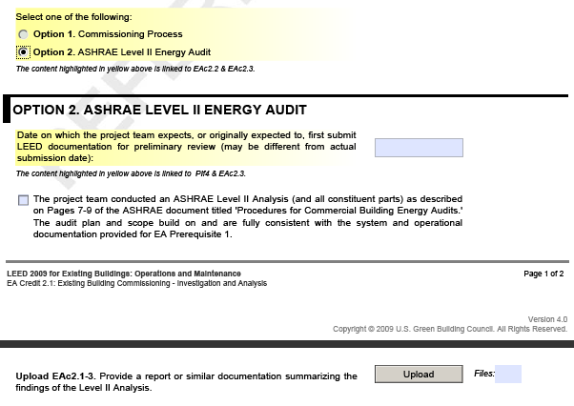
If your team pursued an ASHRAE Level II audit, select Option 2. The data in the space under the Option 2 header will self populate. Then confirm that your audit was consistent with the ASHRAE guidance for Level II audits and upload your audit report or similar summary of analysis and findings.

Slide 5
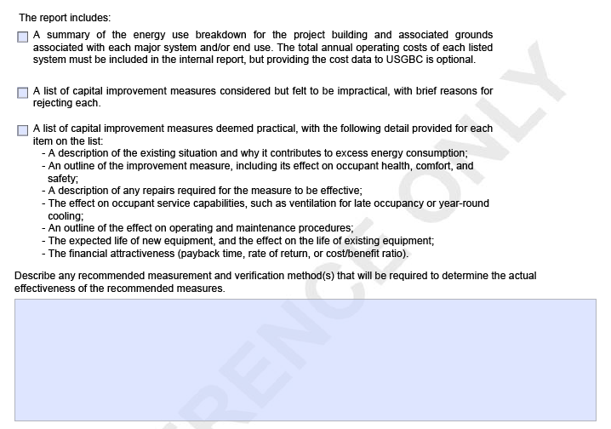
Once you’ve uploaded your Level II Audit report, confirm that it is complete by reviewing and checking off each of these boxes. If your team missed anything, make the appropriate revisions before you submit for review.
Confirm your plan for M&V. This doesn’t necessarily refer to sub-metering or BAS systems, but your on-going plan to implement the recommendations and strategies established by the audit and monitor performance and improvements over time. Be sure to provide a detailed narrative here and don’t just refer to the uploaded documents.

